Slide 1
Process Management
Process Scheduling
Lecture 3 (Live Version)

Slide 2
Overview
Concurrent Execution
Process Scheduling
  Definition
  Process behavior
  Processing environment
  Criteria for good scheduling
  Procedure of process scheduling
Scheduling Algorithms
  For Batch Processing System
  For interactive System

Slide 3
Concurrent Execution
Concurrent processes:
  Logical concept to cover multitasked processes
  Could be virtual parallelism
  Could be physical parallelism
You can assume the two forms of parallelisms are not distinguished in the following discussion

Slide 4

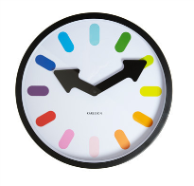
Concurrency Example (Simplistic)
Timeslicing
Process
A
a1 a2
a3
a4 a5 a6
b1 b2 b3
b4 b5
B
Time
t1
t2
t3
Notes:
Mention OS here

Slide 5
Interleaved Execution (context switch)
Context Switch
Process
A
a1 a2
a3
a4 a5 a6
b1 b2 b3
b4 b5
B
OS
Time
t1
t2
t3
Notes:
Tux pic

Slide 6
Multitasking OS
1 CPU: timesliced execution of tasks
p1
p2
p3
CPU
Multiprocessor: timeslicing on n CPUs
CPU 1
p1
p3
CPU 2
p2
p4

Slide 7
Scheduling in OS: A definition
Problems with having multiple processes:
  If [ready-to-run processes] > [CPUs], which should be chosen?
    Similar idea in thread-level scheduling
  Known as the scheduling problem
Terminology:
  Scheduler
    Part of the OS that makes scheduling decision
  Scheduling algorithm
    The algorithm used by scheduler

Slide 8
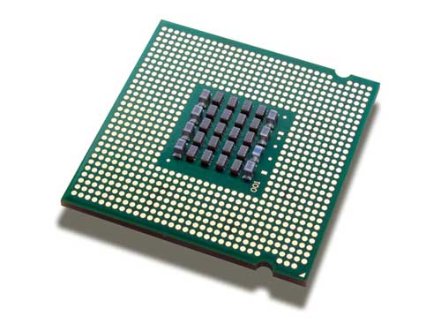
Scheduling: Illustration
selects process
Scheduler
allocates cpu
Processes ready to run
Each process has different requirement of CPU time
  Process behavior
Multiple ways to allocate
  Influenced by the process environment
  Known as scheduling algorithms
A number of criteria to evaluate the scheduler

Slide 9
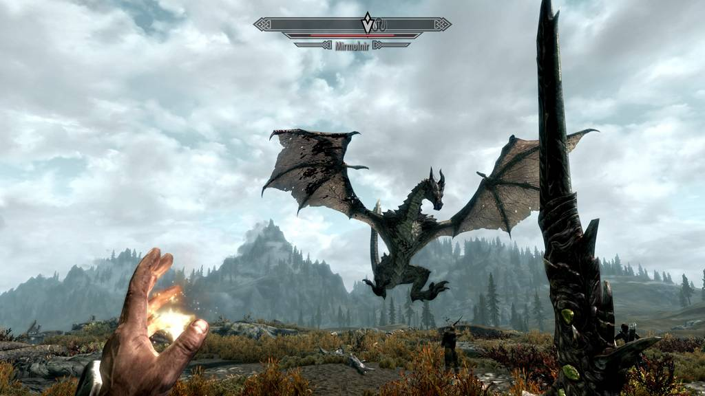
Process Behavior
A typical process goes through phases of:
CPU-Activity:
Computation
E.g. Number crunching
Compute-Bound Process spend majority of its time here
IO-Activity:
Requesting and receiving sercive from I/O devices
E.g. Print to screen, read from file etc
IO-Bound Process spend majority of its time here

Slide 10
3 Types of Processing Environment
Batch Processing:
  No user: No interaction required, No need to be responsive
Interactive (or Multiprogramming):
  With active user interacting with system
  Should be responsive, consistent in response time
Real time processing:
  Have deadline to meet
  Usually periodic process

Slide 11
Criteria for Scheduling Algorithms
Many criteria to evaluate an scheduling algorithm
Criteria for all processing environments:
Fairness:
  Should get a fair share of CPU time
    per process basis OR
    per user basis
  Also mean no starvation
Balance:
  All parts of the computing system should be utilized

Slide 12
When to perform scheduling?
Two types of scheduling policies
Non-preemptive (Cooperative)
  A process stayed scheduled until:
  it blocks OR
  give up the CPU voluntarily
Preemptive
  A process is given a fixed time quota to run
    Possible to block or give up early
  At the end of the time quota:
    Another process get picked if available

Slide 13
Scheduling a Process: Step-by-Step
1
2
3
4
5
If Context switch is needed:
Pick a suitable process P to run base on scheduling algorithm
Setup the context for P
Let process P run
Scheduler is triggered ( OS takes over )
Context of current running process is saved and placed on blocked queue / ready queue

Slide 14
Scheduling for
Batch Processing

Slide 15
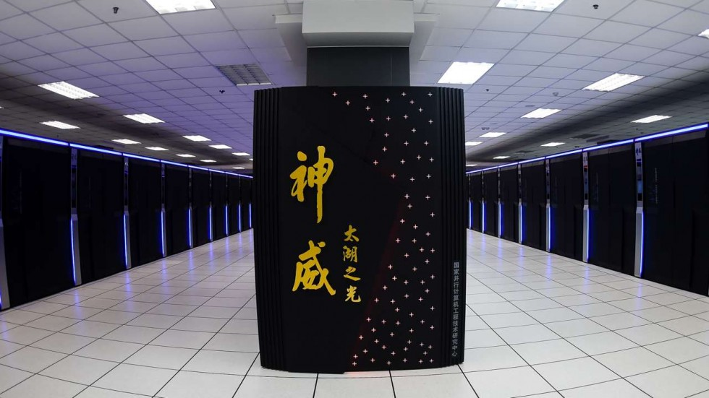
Overview – Batch Processing
On batch processing system:
  No user interaction
  Non-preemptive scheduling is predominant
Scheduling algorithms are generally easier to understand and implement
  Variant/Improvement are used for scheduling other type of systems
Three algorithms covered:
  First-Come First Served (FCFS)
  Shortest Job First (SJF)
  Shortest Remaining Time Next (SRT)
Sunway TaihuLight
93 petaflops

Slide 16
Criteria for batch processing
Turnaround time:
  Total time taken, i.e. [finish - start time]
  Related to waiting time: time spent waiting for CPU
Throughput:
  Number of tasks finished per unit time
CPU utilization:
  Percentage of time when CPU is working on a task

Slide 17
First-Come First-Served: FCFS
General Idea:
Guaranteed to have no starvation:
  The number of tasks in front of task X in FIFO is always decreasing
  ➔ task X will get its chance eventually

Slide 18
First-Come First-Served: Illustration
Tasks Queue
A: 8 TUs
B: 5 TUs
C: 3 TUs
C: 3 TUs
B: 5 TUs
C: 3 TUs
Notes:
Talk about alternative drawing (time chart)
Talk about waiting time, turnaround time.

Slide 19
First-Come First-Served: Shortcomings
Simple reordering can reduce the average waiting time!
Convoy Effect:
  First task (task A) is CPU-Bound and followed by a number IO-Bound tasks X
  Tasks A running
    All tasks X waiting in ready queue (I/O device idling)
  Tasks A blocked on I/O
    All tasks X execute quickly and blocked on I/O (CPU idling)
Notes:
Talk about implementation

Slide 20
Shortest Job First: SJF
General Idea:
  Select task with the smallest total CPU time
Notes:
  Need to know total CPU time for a task in advance
  Given a fixed set of tasks:
    Minimizes average waiting time

Slide 21
Shortest Job First: Illustration
Tasks Queue
A: 8 TUs
B: 5 TUs
C: 3 TUs
Notes:
Mention Task "Queue" is not really a Queue
Mention Starvation

Slide 22
Shortest Job First: Predicting CPU Time
Guess the future CPU time by the previous CPU-Bound phases
Common approach (Exponential Average):
  Predicted_{n+1} = αActual_{n}+(1-α)Predicted_{n}
  Actual_{n} = The most recent CPU time consumed
  Predicted_{n} = The past history of CPU Time consumed
  α = Weight placed on recent event or past history
  Predicted_{n+1} = Latest prediction

Slide 23
Shortest Remaining Time: SRT
General Idea:
  Variation of SJF:
    Use remaining time
    Preemptive
  Select job with shortest remaining (or expected) time
Notes:
  New job with shorter remaining time can preempt currently running job
  Provide good service for short job even when it arrives late

Slide 24
Shortest Remaining Time First: Illustration
Tasks
Arrival Time
A: 8 TUs
Time 0
C: 3 TUs
Time 1
B: 5 TUs
Time 2

